Slide 1


Characterization of organics in table salt
Lucas Reynoso¹, Maitrayee Bose²
¹School for Engineering of Matter, Transport & Energy, Arizona State University, ²School for Earth and Space Exploration, Arizona State University
Annual Arizona NASA Space Grant Consortium Symposium
April 22nd and 23rd 2022

Slide 2
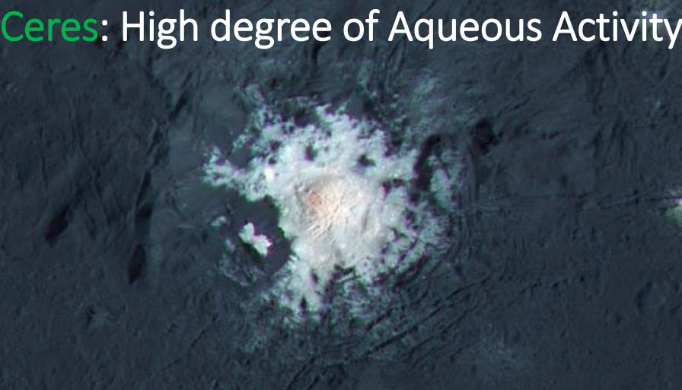
Introduction
Ceres is the most water-rich object (~25 wt%) in the inner solar system after Earth Hendrix et al. (2019), Astrobiology
Shows localized areas of hydrated sodium carbonates and sodium chlorides
The dome of Cerealia facula in Occator Crater. The bright material is mainly sodium carbonate. Image Credit: NASAm JPL-Caltech, UCLA, MPS/DLR/IDA

Slide 3
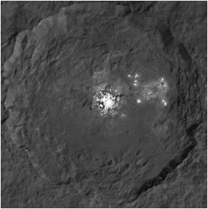
Motivation
Research Questions
Will organics accumulate as ‘fossils’ in salt crystals forming from brine solutions?
Is there a significant amount of carbon that is traceable and can be characterized?
Occator Crater observed in high altitude mapping orbit (HAMO) by the Dawn Spacecraft Image Credit: NASA, JPL-Caltech
Sample Return Mission to an ocean world will happen in the next decade!
Notes:
Perform terrestrial and laboratory analog work to better understand the chemistry of brines and organic matter
Characterize analog material to provide a comparison to future missions to Ceres

Slide 4
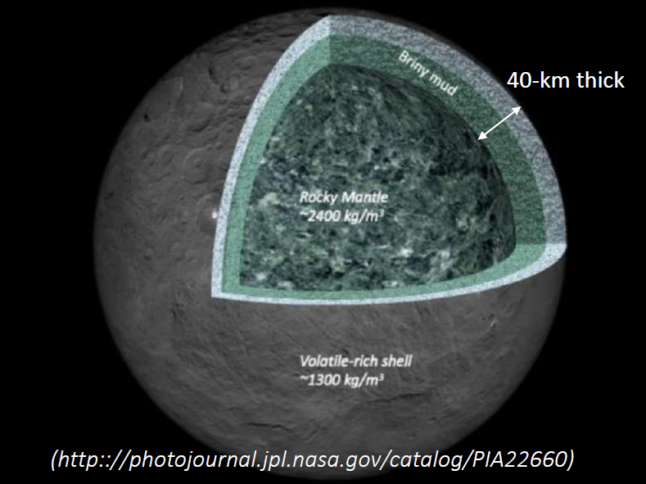
Why Salts on Ceres?
Could provide insight into the formation and nature of organics in the asteroid belt
Understanding how brines form and evolve will help us learn about mantle processes in ice-rich bodies

Slide 5
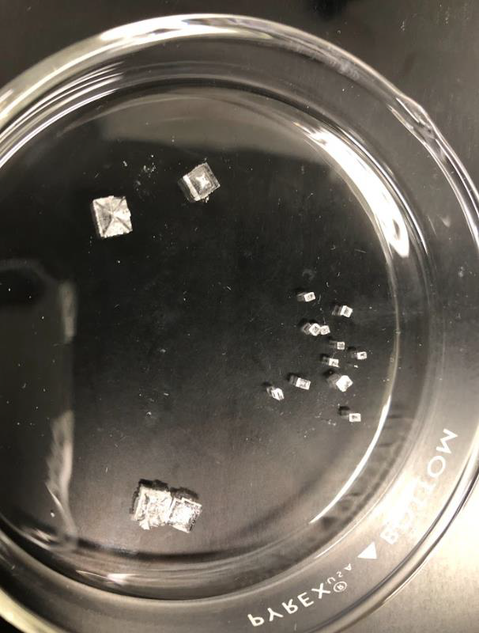
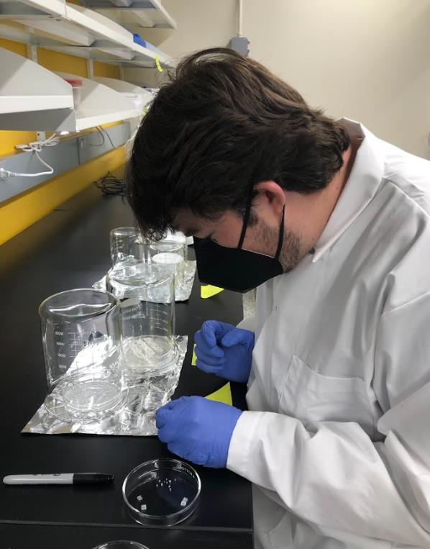
Methods
Sodium chloride crystals were grown from a supersaturated solution
New solution was introduced twice a week
Glycine was incorporated at a concentration of 500mg per 100ml

Slide 6
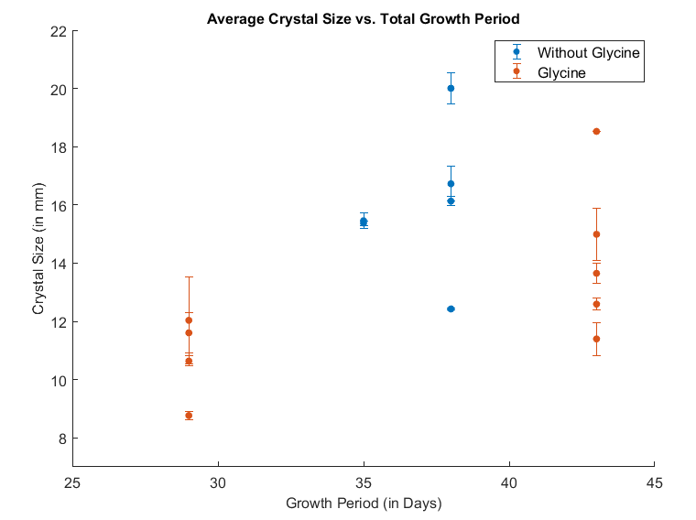
Results
Longer growth periods result in larger crystals
The glycine crystals grew faster than the pure NaCl crystals

Slide 7
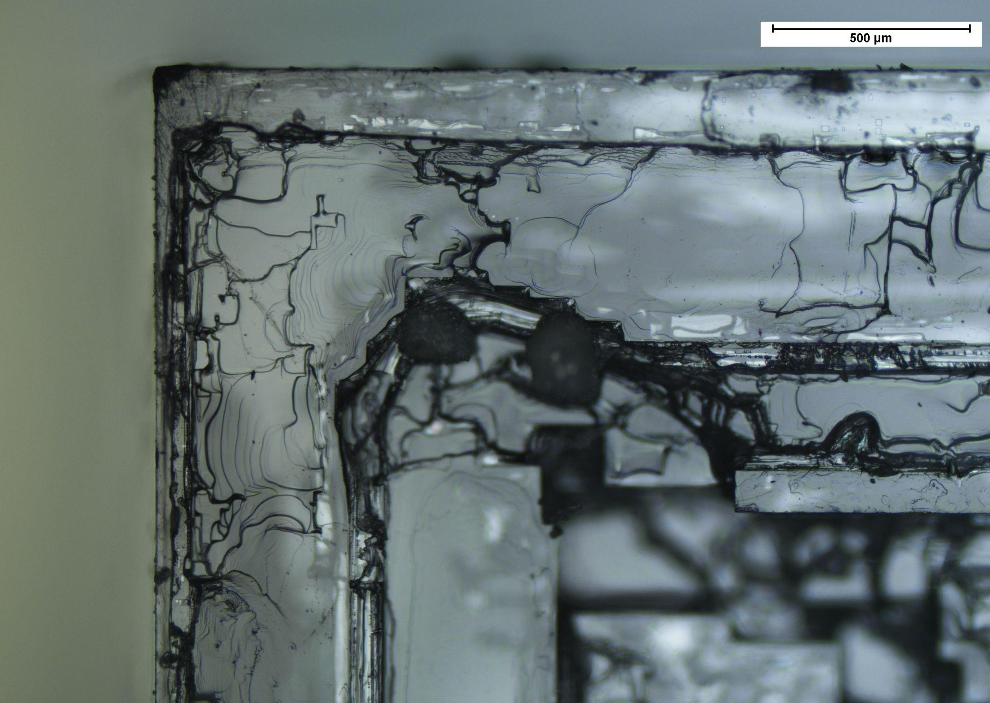
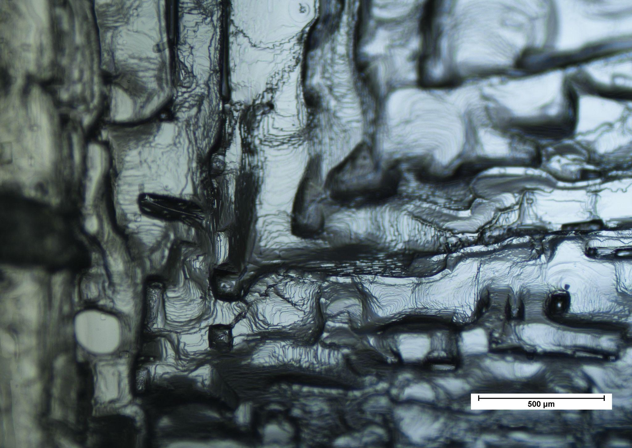
Results
Figure 1 - Without Glycine
Figure 2 - Glycine

Slide 8
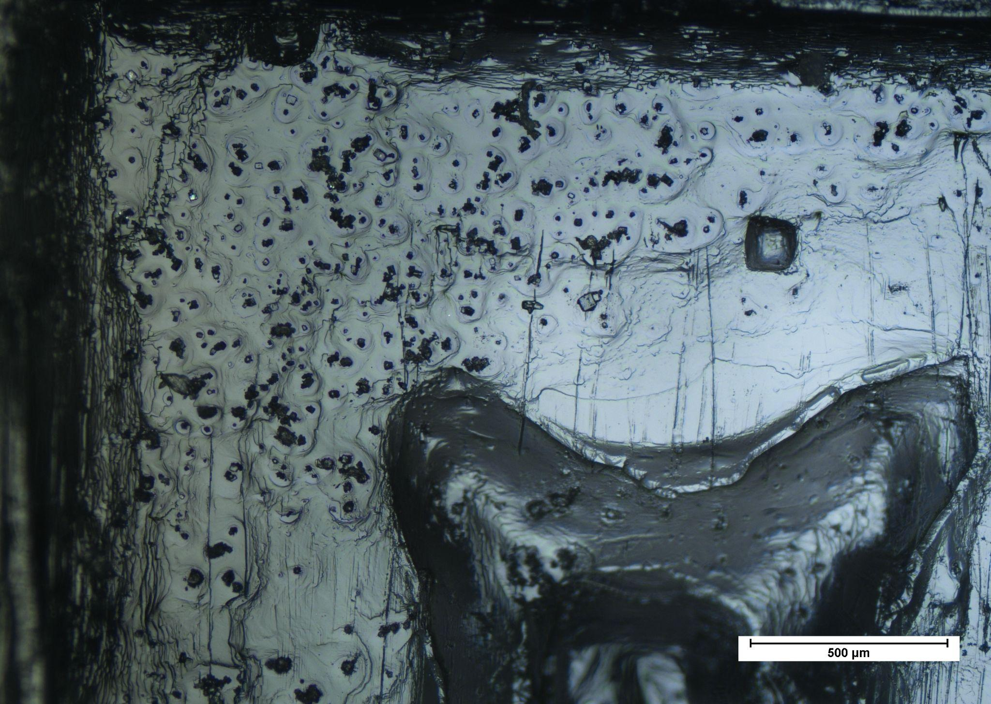
Results
Figure 1 - Without Glycine
Figure 2 - Glycine

Slide 9
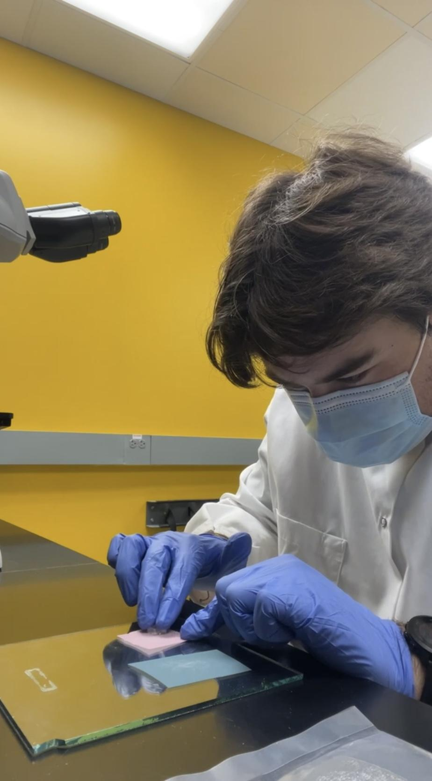
Conclusion & Future Work
The crystal structure after glycine incorporation is vastly different from a pure sodium chloride crystal
Develop a methodology to polish and mount samples
Trace carbon contents and isotopic compositions using various techniques such as NanoSIMS, IMS 6f SIMS, Raman Spectroscopy, and Cathodoluminescence Spectroscopy

Slide 10


Acknowledgements
I want to thank my mentor, Dr. Maitrayee Bose for furthering my research endeavors and always supporting me.
I would also like to thank Dr. Julie Castillo-Rogez of NASA’s Jet Propulsion Laboratory (JPL) for all of her advice and time.
Lastly, I would like to thank ASU/NASA Space Grant for funding this project.

